Slide 1
Submitting artifacts to the Bonaventure program e-portfolio
Quincy University

Slide 2
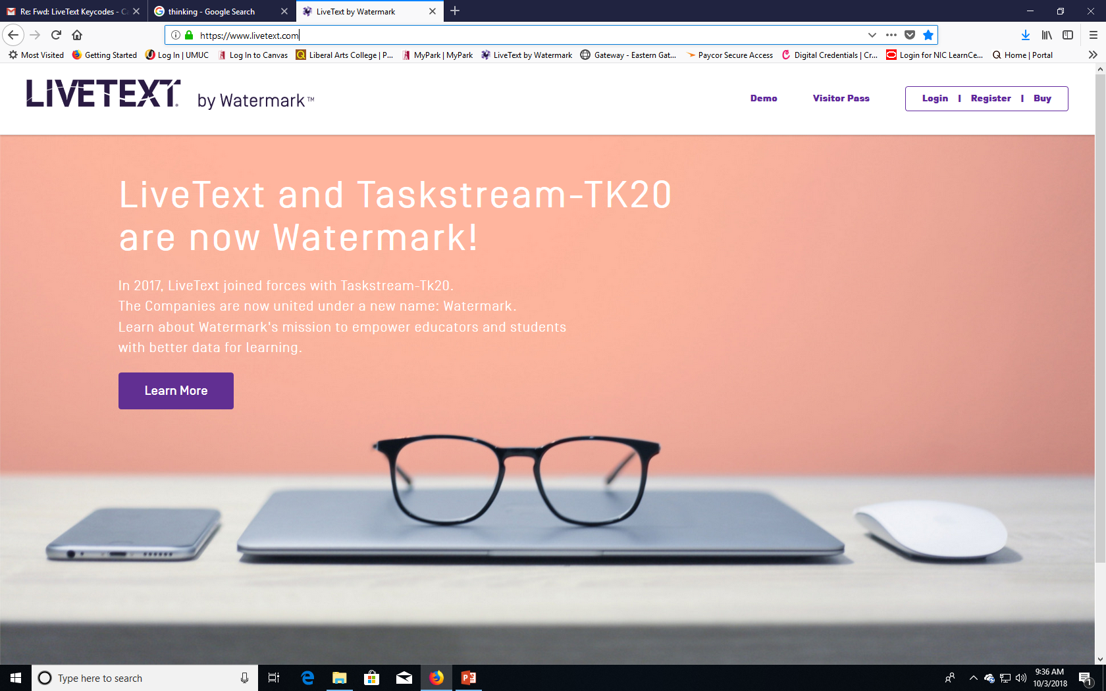
How do I access the Bonaventure program e-portfolio?
LiveText
Access the external website for LiveText at livetext.com

Slide 3
How do I access the Bonaventure program e-portfolio?
LiveText
You will Receive an invitation email to register your LiveText Account
If you have deleted the invitation email, didn’t activate your account, or didn’t receive an invitation email, please email Dr. Barb Rowland, Director of Academic Assessment at rowlaba@quincy.edu

Slide 4
Livetext dashboard
LiveText
Students should see a list of courses on the LiveText Dashboard
One of those courses should be BPP 110, BPP 310, or BPP 410
These are the courses that house the Bonaventure Program ePortfolio

Slide 5
Submitting artifacts to the BP E-Portfolio through livetext
LiveText
Your goal is to upload artifacts for each of the BP Learning outcomes listed in the portfolio.
An artifact is anything that can provide evidence of your education and experiences. This will likely be coursework, including tests, essays, projects, presentations, or anything else assigned to you in class.
In many cases, you have already uploaded artifacts into LiveText for many of your courses. You may have already uploaded assignments to Written Communication, Problem Solving, Critical Thinking, or Ethical Reasoning, just to name a few.

Slide 6
Submitting artifacts to the BP E-Portfolio through livetext
LiveText
While these assignments may already be in LiveText, they are housed in your individual courses.
For example, you may have uploaded a Written Communication Assignment in LiveText for your English 111 or 112 courses.
When you uploaded this assignment into LiveText, you uploaded it to your English 111 or 112 course shell within LiveText.
When completing the Bonaventure Program e-Portfolio, we now need to upload that assignment into the BPP 410 Portfolio as well.

Slide 7
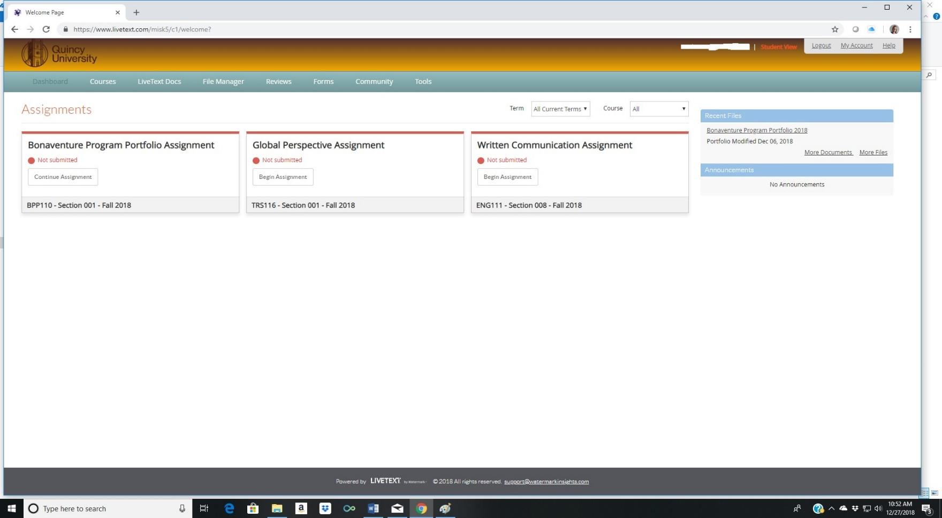
Accessing the Bonaventure program e-portfolio
Once you log in to LiveText you will see your dashboard. The dashboard lists all the courses you are enrolled in. The BP E-Portfolio is listed as either BPP 110 or BPP 310, or 410. For this class, we want to use the BPP 410 portfolio.

Slide 8
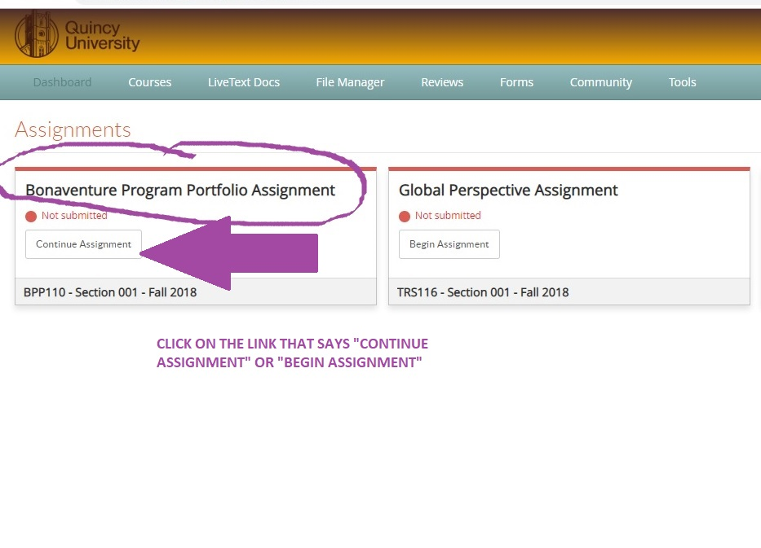
Accessing the Bonaventure program e-portfolio
To submit an artifact to the Bonaventure Program E-Portfolio you will need to first click on the link that says: BEGIN ASSIGNMENT or CONTINUE ASSIGNMENT (if you have already accessed the portfolio before).

Slide 9
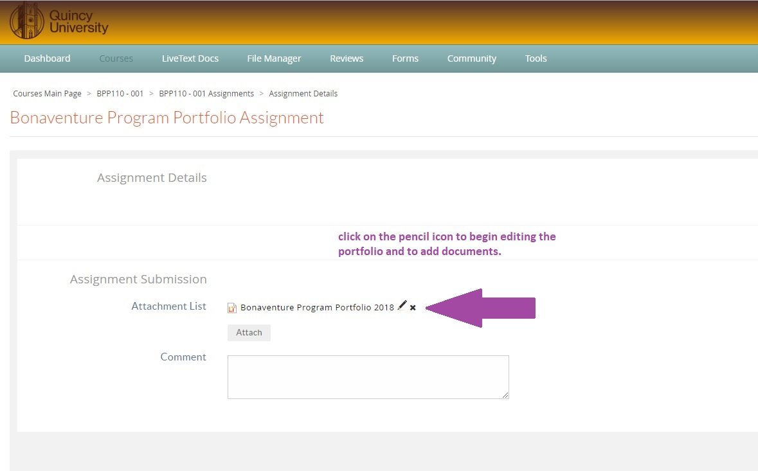
Accessing the Bonaventure program e-portfolio
You are now ready to edit the e-portfolio and add artifacts. Click on the pencil icon to begin editing and adding content to your portfolio.

Slide 10
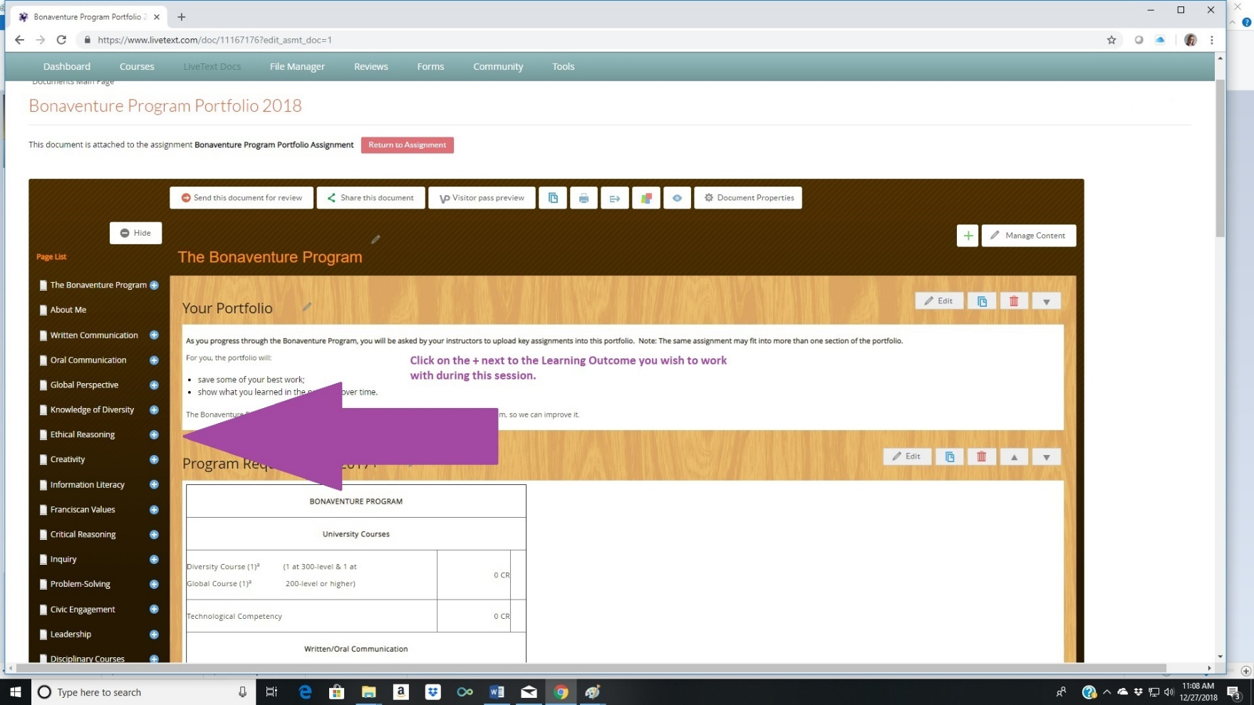
Accessing the Bonaventure program e-portfolio
You can see the full e-portfolio. You will need to determine which learning outcome you wish to work with during this session. This is where you will upload your artifact. Click on the + sign next to the Learning Outcome you want to work with.

Slide 11
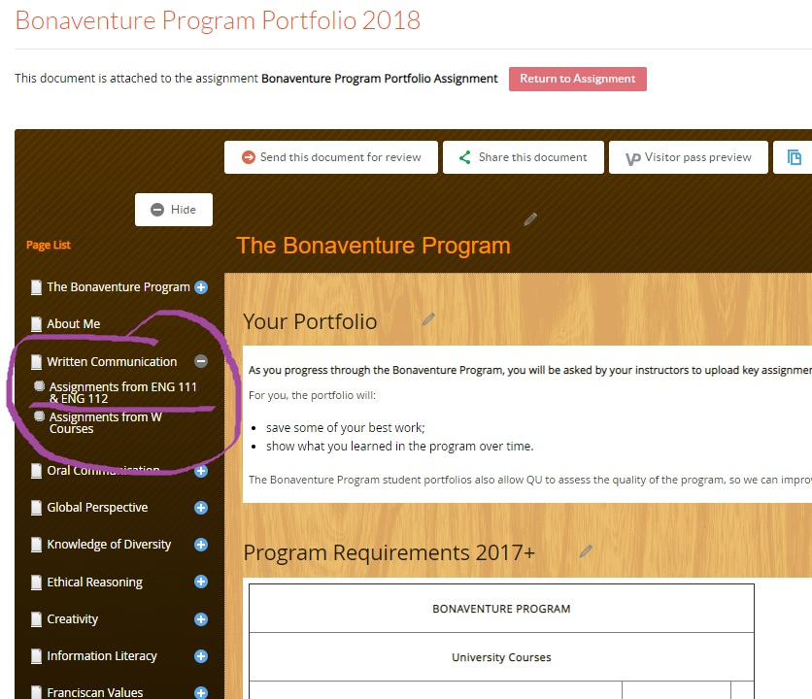
Uploading artifacts to the Bonaventure program e-portfolio
In this example, we will use the Written Communication Learning Outcome, specifically they Assignments from Eng. 111 and Eng. 112. You would click on the Assignments from Eng. 111 & Eng. 112 link.

Slide 12
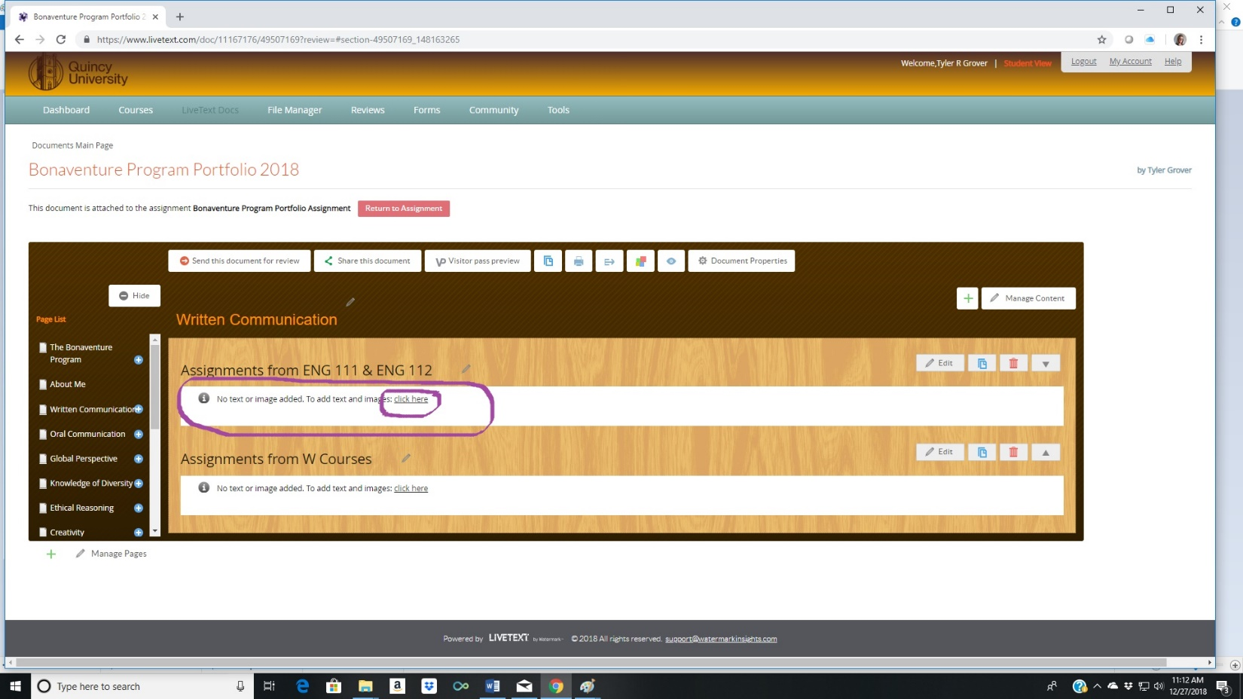
Uploading artifacts to the Bonaventure program e-portfolio
Now you are able to begin uploading an artifact for this learning outcome. Click on the link that says CLICK HERE.

Slide 13
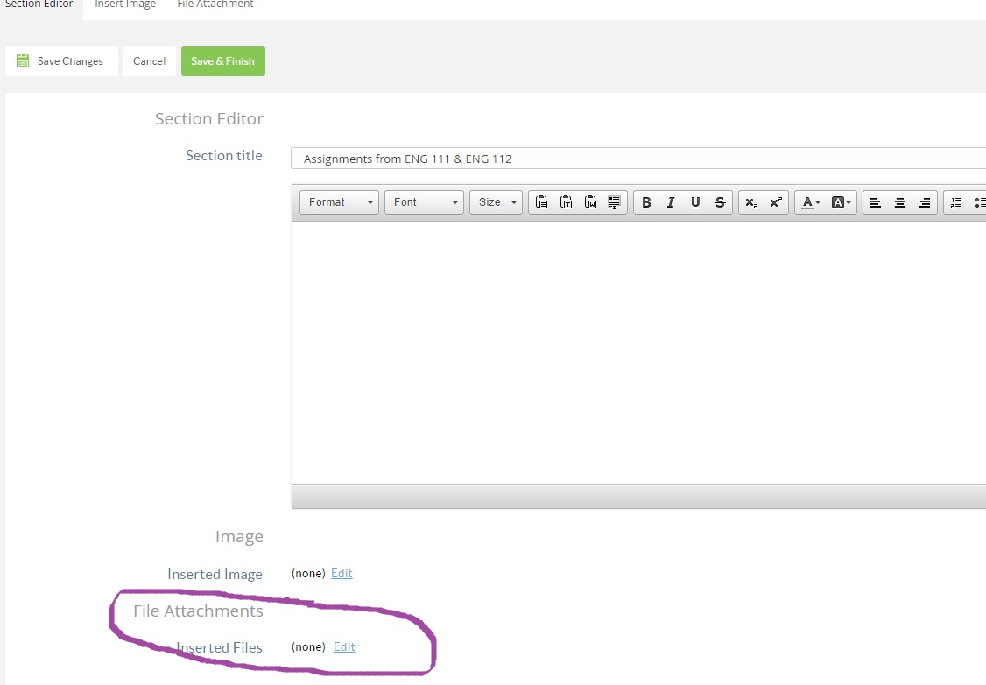
Uploading artifacts to the Bonaventure program e-portfolio
From here it is simply attaching the appropriate file. Click on EDIT under File Attachments.

Slide 14
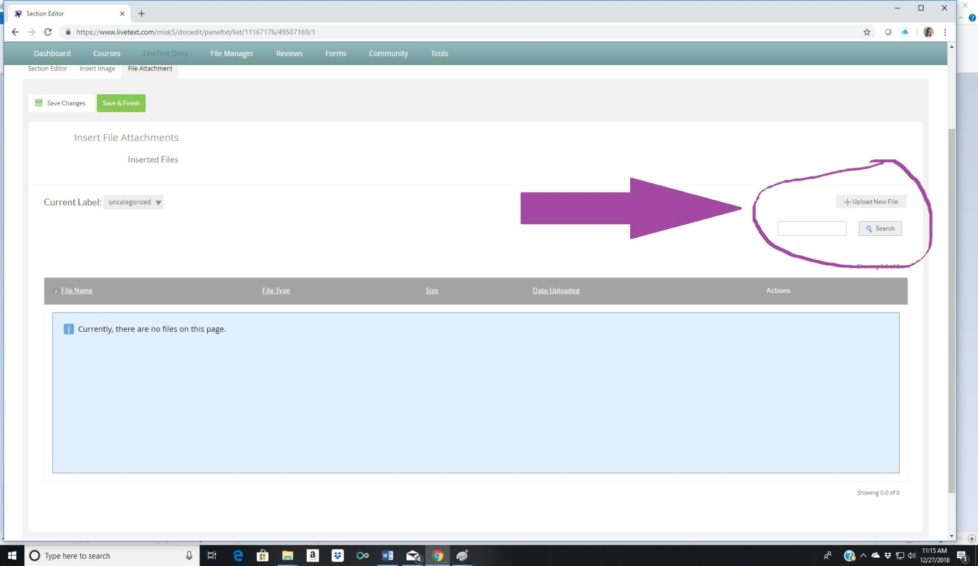
Uploading artifacts to the Bonaventure program e-portfolio
Click on UPLOAD NEW FILE and search for the appropriate file you wish to attach/upload.

Slide 15
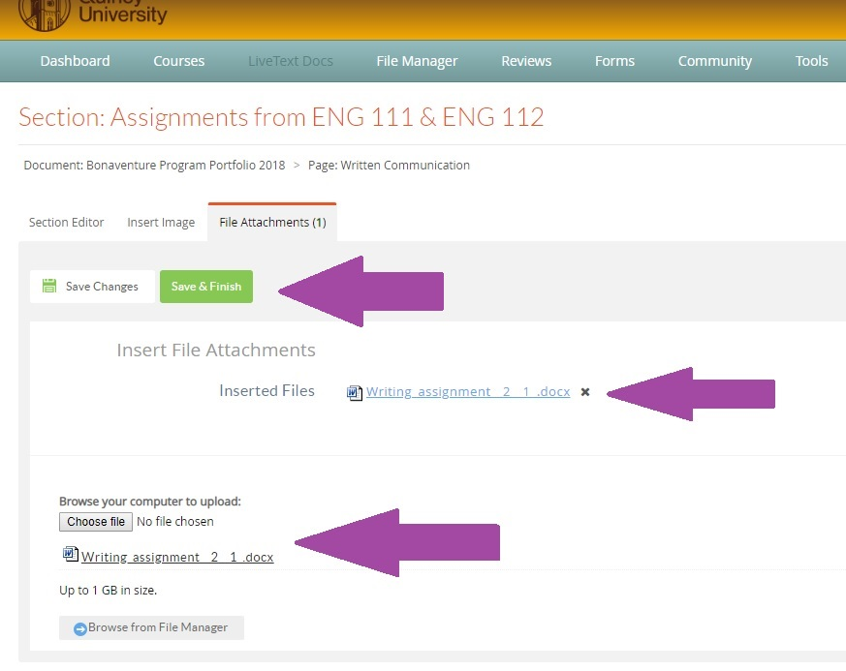
Uploading artifacts to the Bonaventure program e-portfolio
Attach the file, make sure it is listed as attached, and then click on SAVE AND FINISH.

Slide 16
You have now successfully uploaded an artifact to the Bonaventure Program e-Portfolio! You will continue this process as you begin to upload artifacts for the learning outcomes listed on the left hand side of the portfolio. If you have any additional questions about the portfolio or uploading artifacts, please contact Cr. Barb Rowland, director of academic assessment and QU livetext coordinator at rowlaba@quincy. edu
Uploading artifacts to the Bonaventure program e-portfolio

Slide 17
The Bonaventure Program portfolio
That’s it! You did it!

